Slide 1
Python for finance
Lab 2.

Slide 2

MANAGING DATA WITH PANDAS
AI generated image using keywords : managing data with pandas

Slide 3
What is Pandas ?
Pandas stands for “panel data”
Pandas is an open-source data analysis and manipulation tool
Pandas provides two main data structures :
Series : one dimensional array, associated with labels
Dataframes : two dimensional tabular data with labeled rows and columns
Useful features of Pandas :
Missing data : detection, filling, dropping
Data wrangling : filter, group, merge, pivot
Input/output tools : reading from and to various file formats
Time series support : data range generation, frequency conversion, rolling window calculations

Slide 4
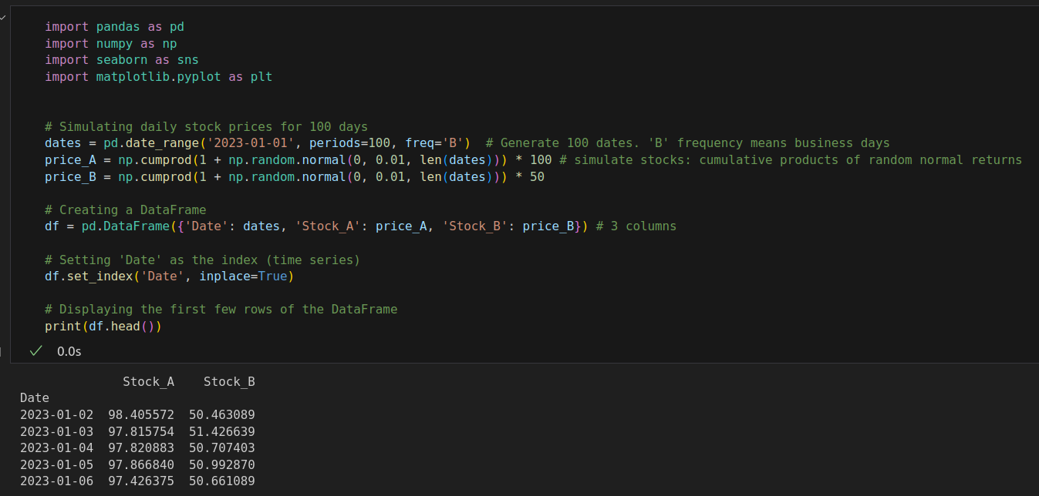
A first example : simulating stock prices

Slide 5
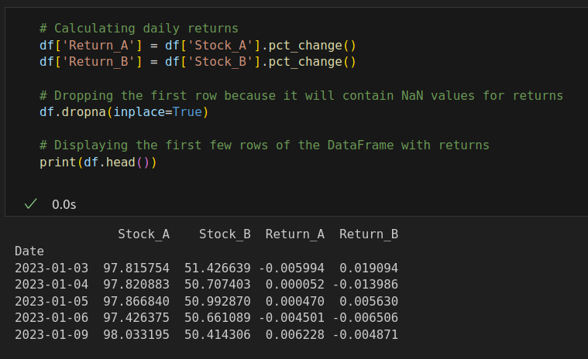
A first example : simulating stock prices

Slide 6
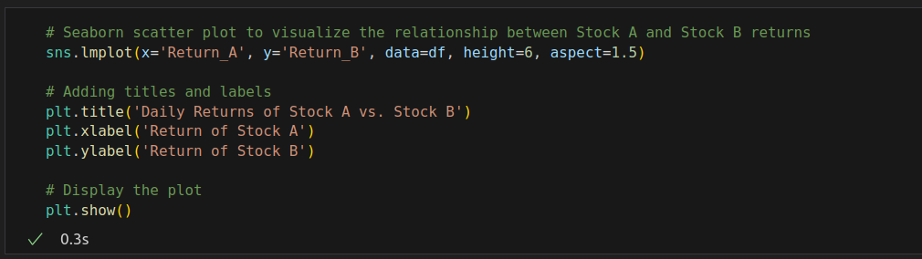
A first example : simulating stock prices

Slide 7
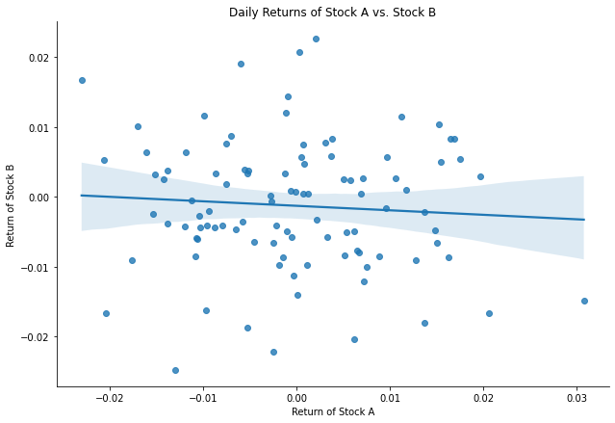
A first example : simulating stock prices

